Slide 1
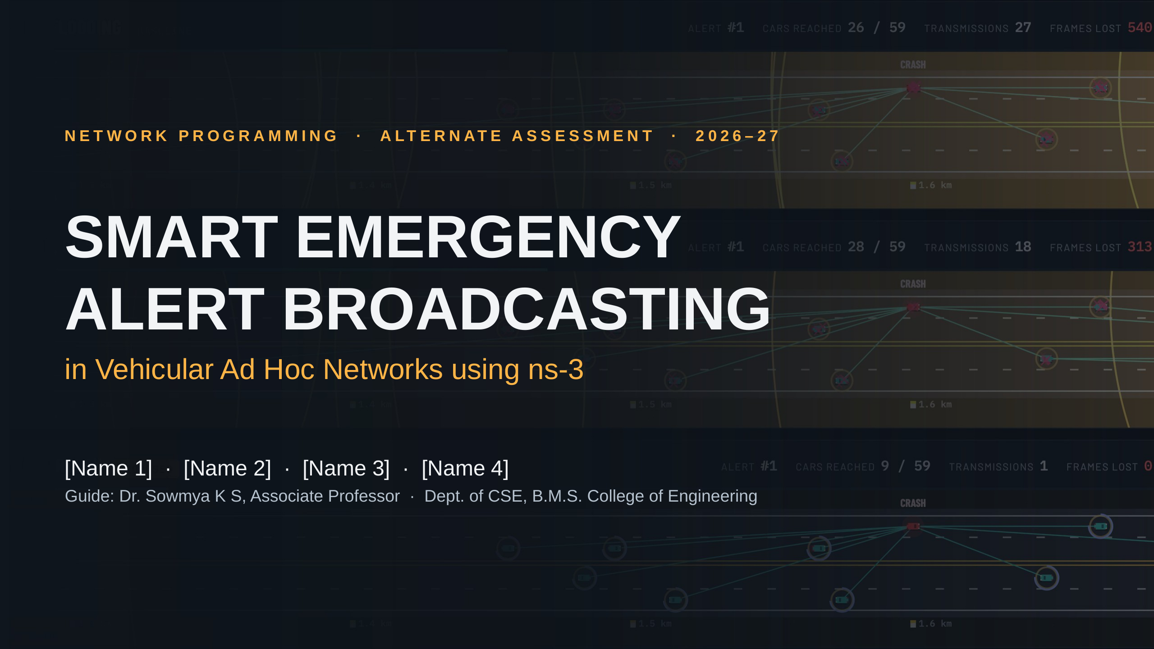
Notes:
Introduce the team and the topic: when a car crashes on a highway, how do we warn the cars behind it within milliseconds? The background is a real frame from our ns-3 simulation: three copies of the same highway, each using a different rule for passing the warning on.

Slide 2
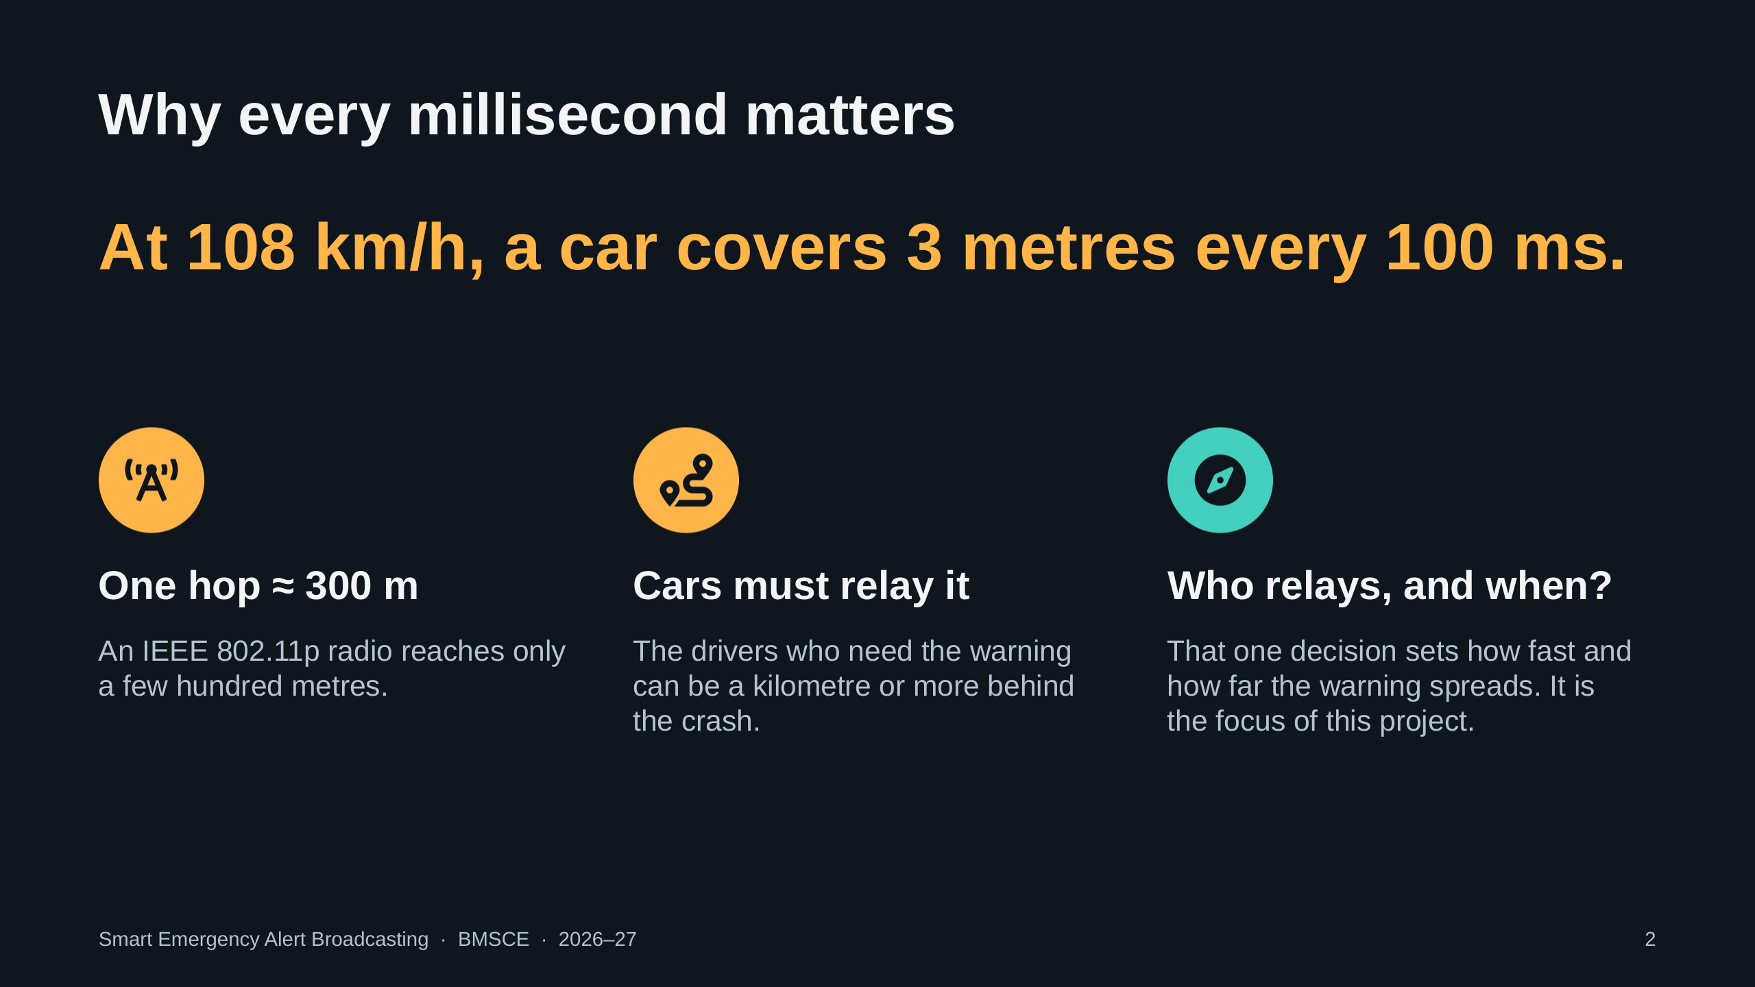
Notes:
108 km/h is 30 m/s, so every 100 ms of warning delay is 3 metres of road. A single 802.11p transmission reaches only about 300 m, but the cars that most need the warning may be far behind. So the alert must be relayed car to car, and the rule each car uses to decide whether and when to relay decides everything.

Slide 3
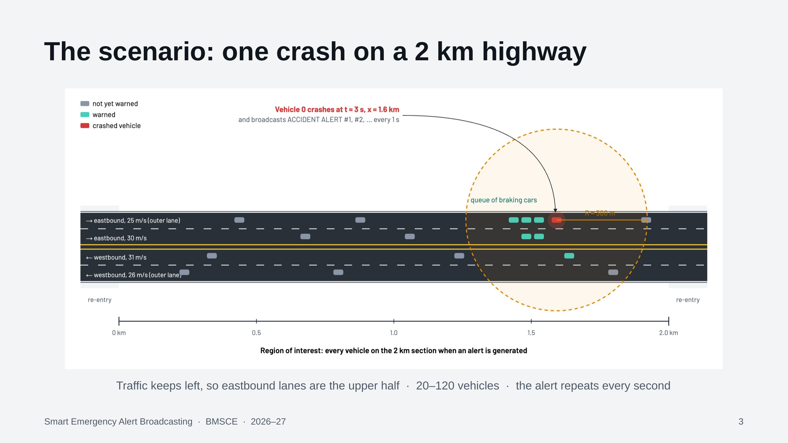
Notes:
A straight 2 km highway, two lanes each way, cars at 25 to 31 m/s. At t = 3 s Vehicle 0 crashes at the 1.6 km mark and blocks the eastbound side. It broadcasts an ACCIDENT ALERT and repeats it every second with a new sequence number. Eastbound cars brake into a queue behind it. We score delivery over every vehicle on the 2 km section, the region of interest.

Slide 4
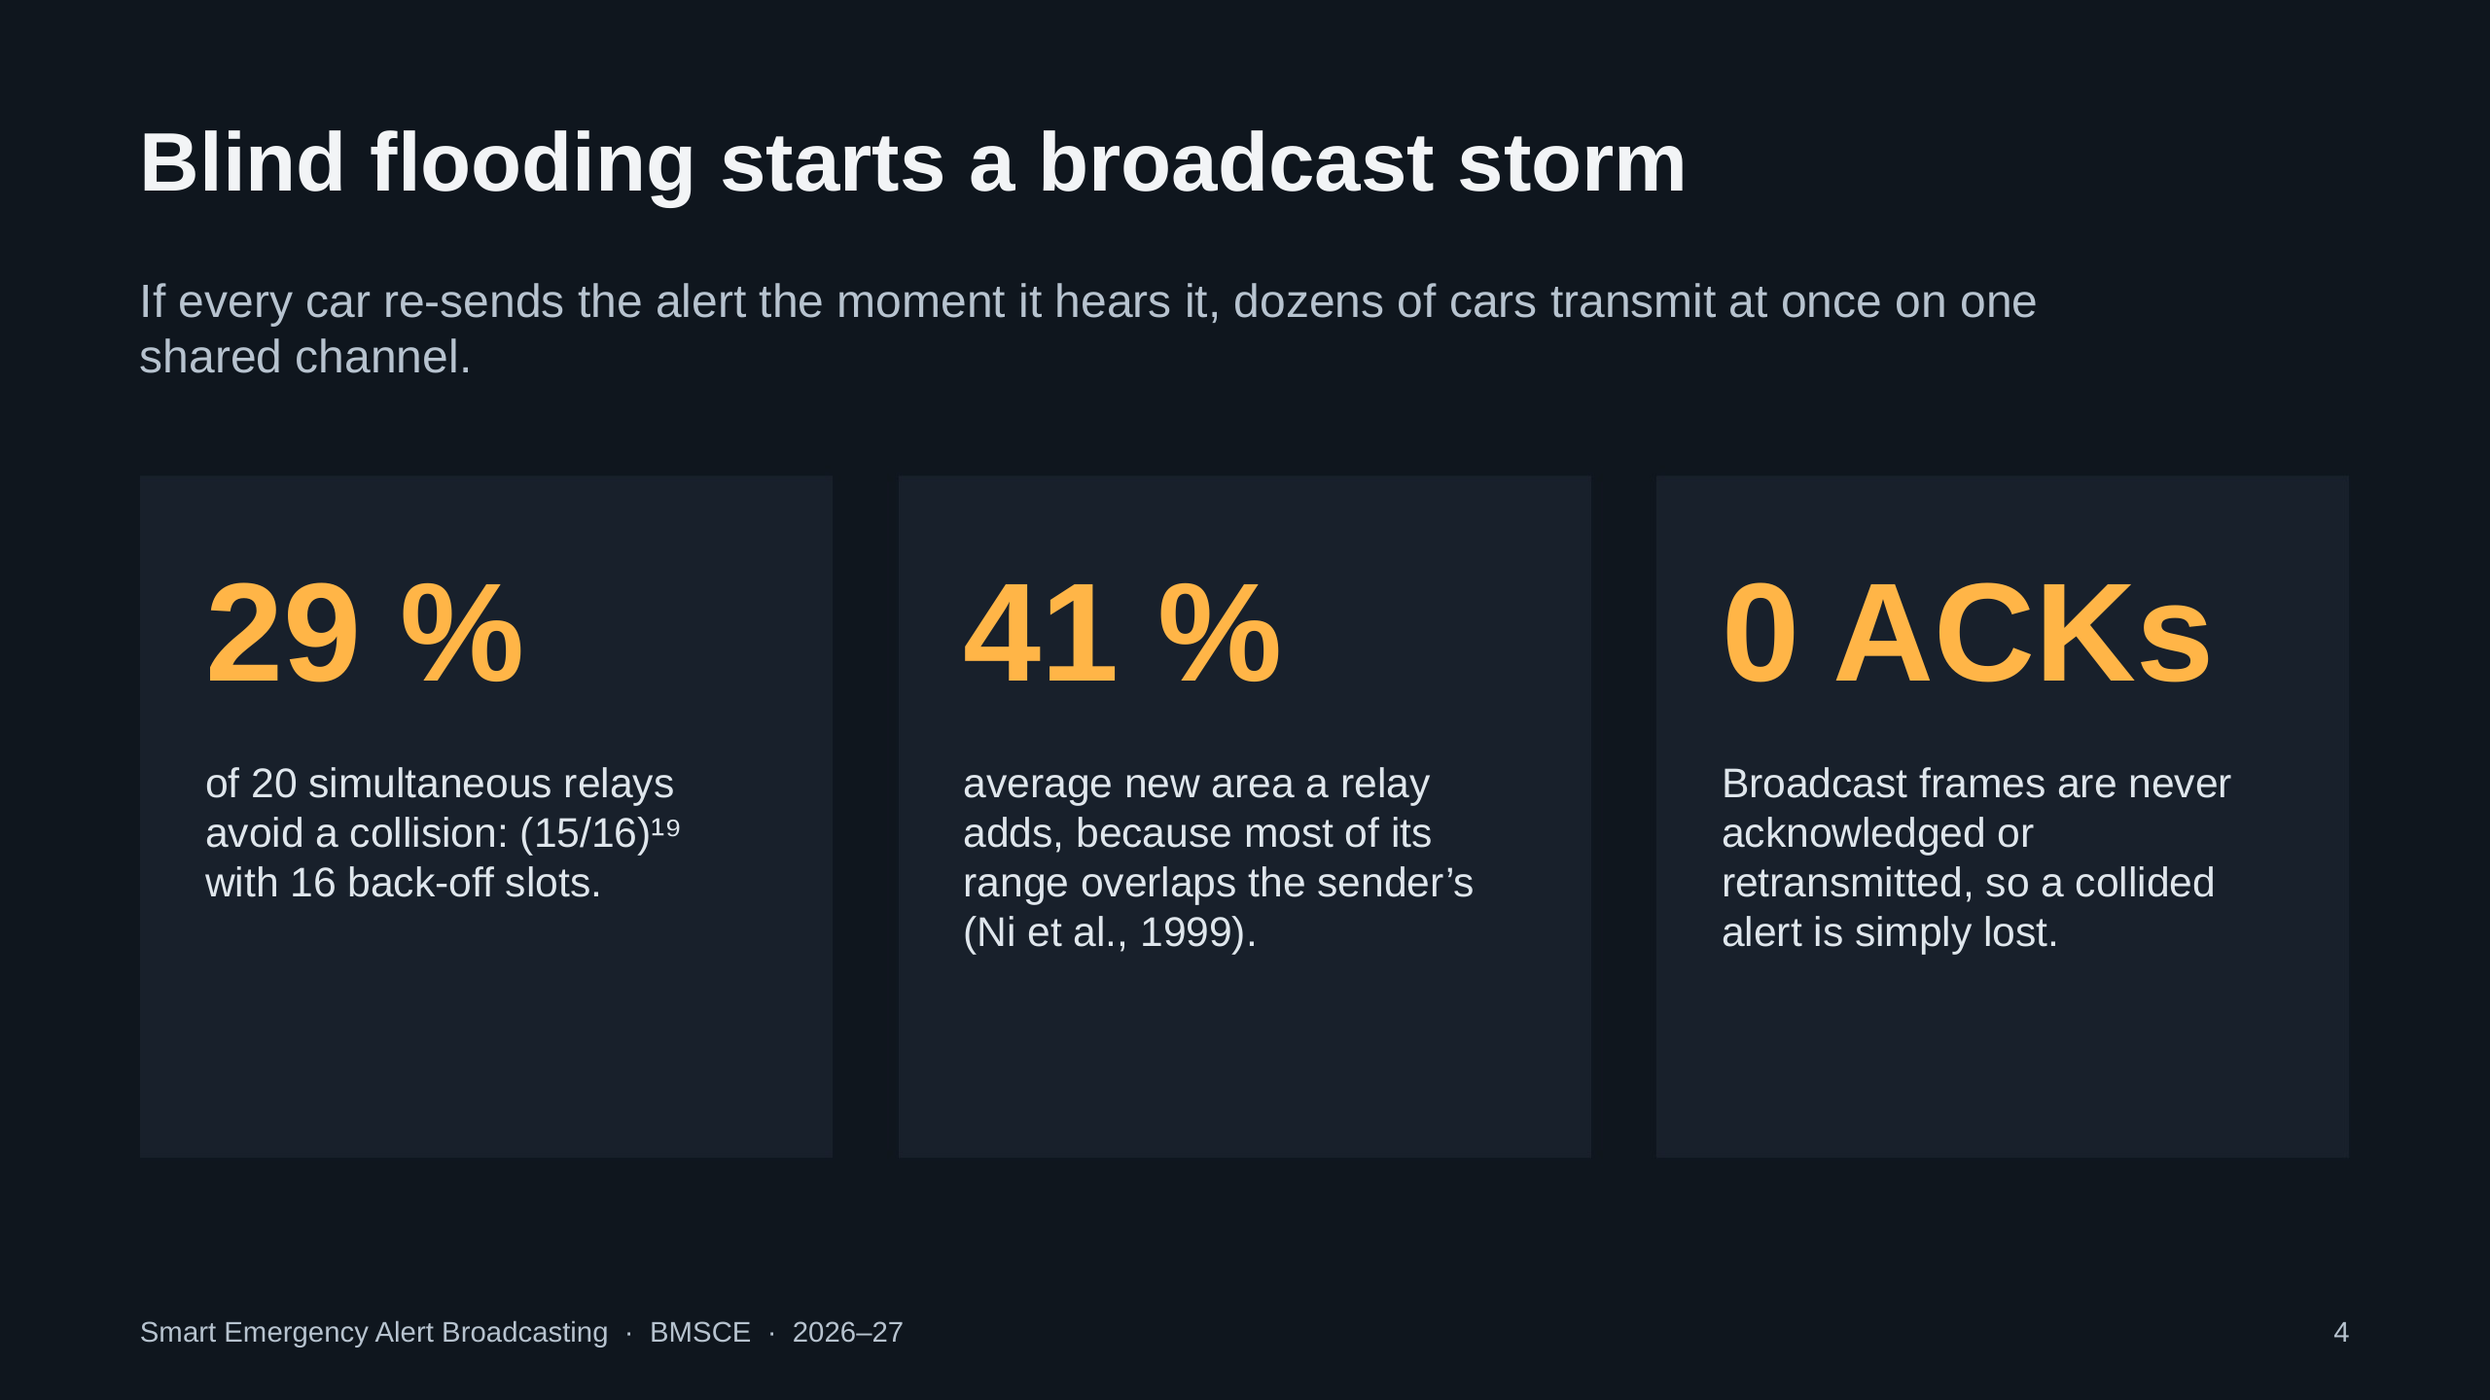
Notes:
Flooding fails for three reasons. With 20 neighbours relaying after the same frame, each picks one of 16 back-off slots and only about 29 percent pick a slot nobody else chose. Ni et al. showed a relay adds on average only 41 percent new coverage. And broadcast has no ACK or retry at the MAC, so a collision just loses the alert.

Slide 5
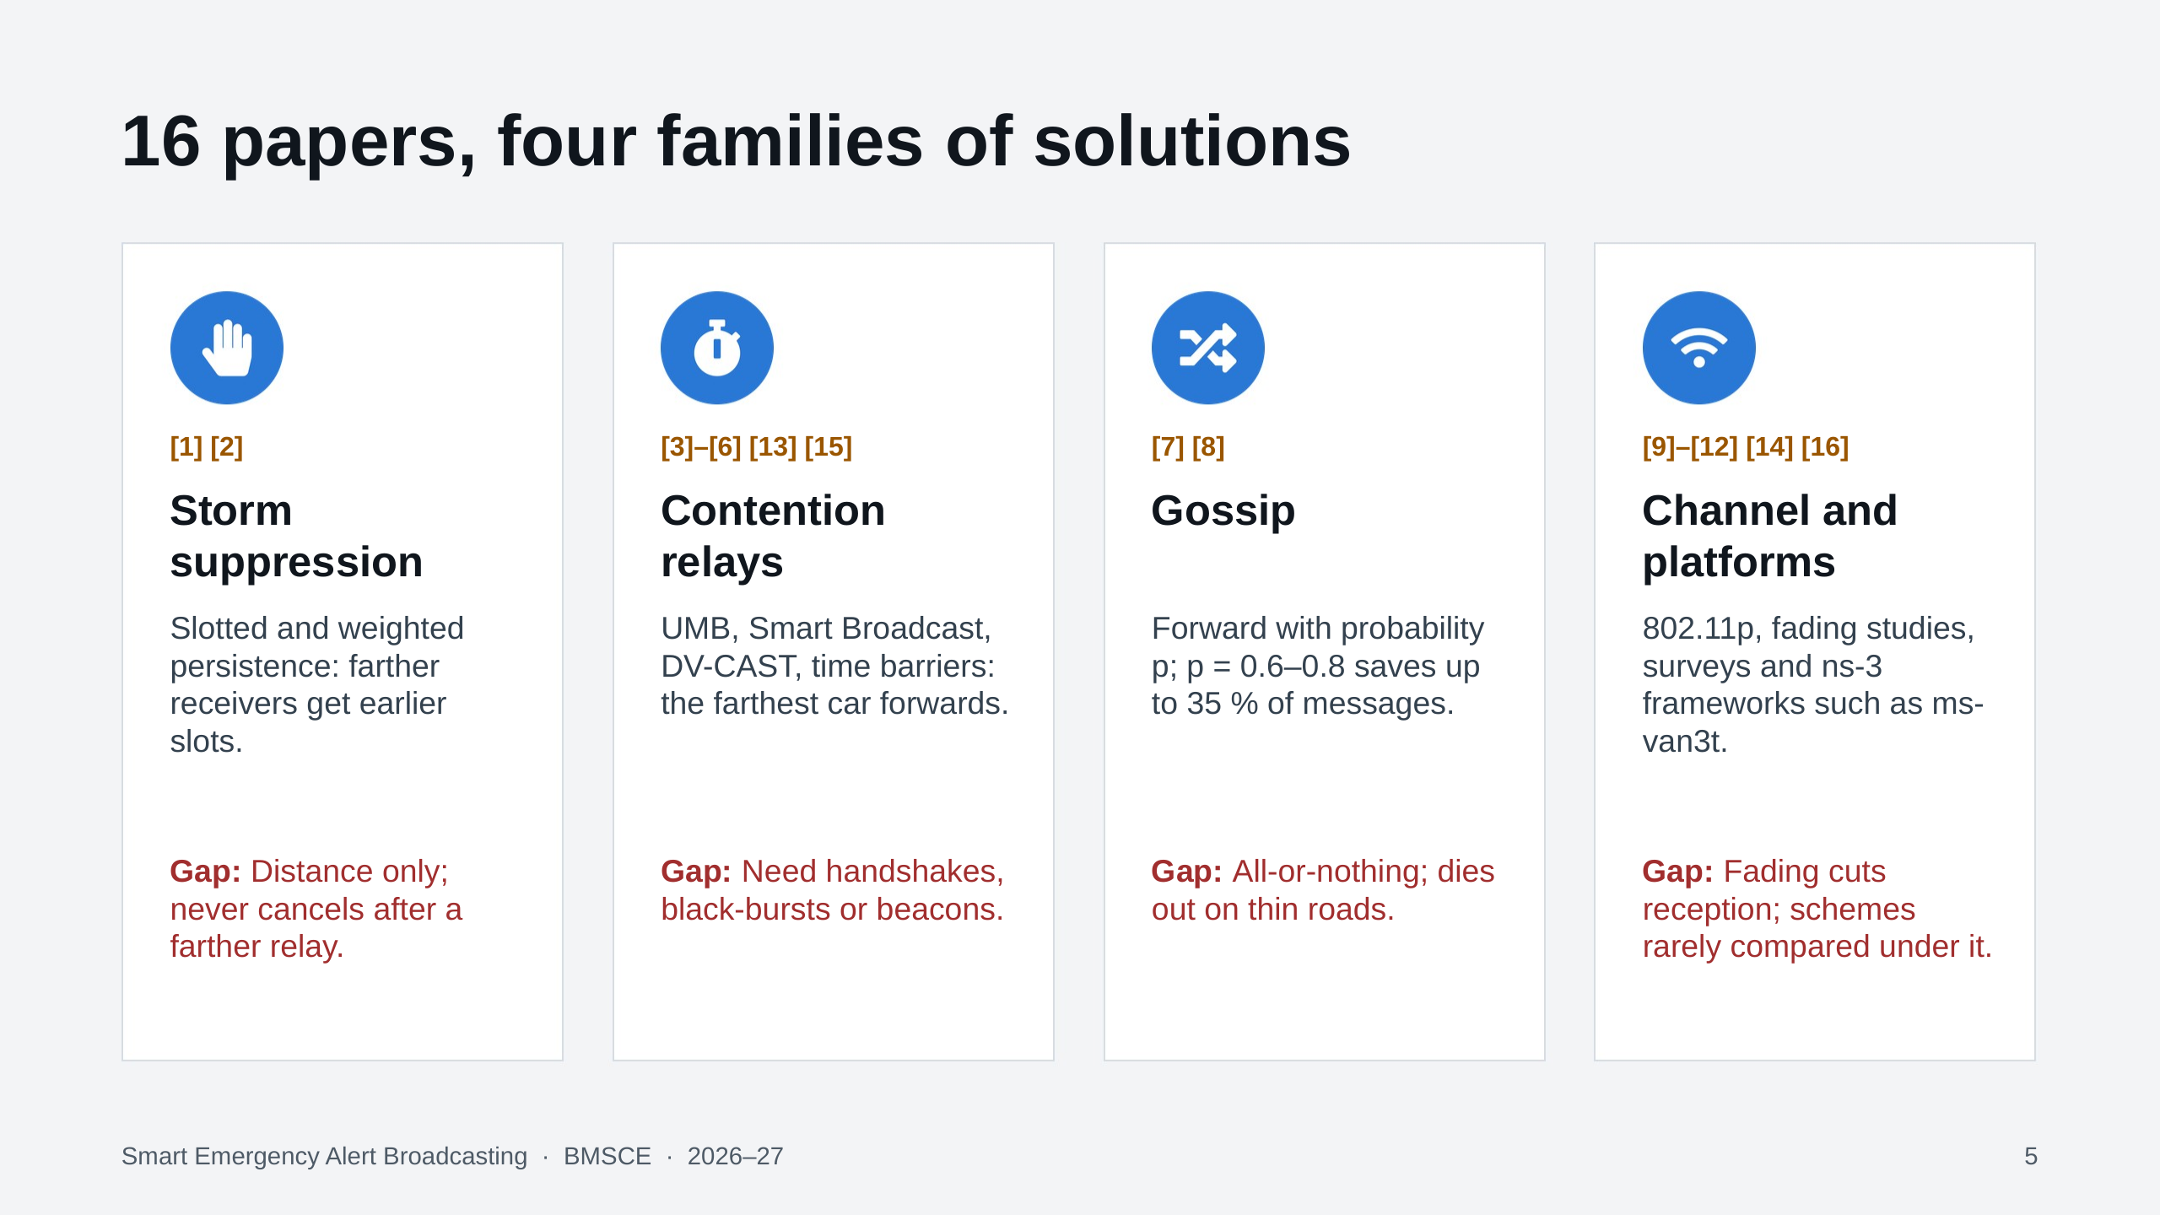
Notes:
We reviewed 16 peer-reviewed papers in four families. Suppression schemes give farther cars earlier slots but never cancel. Contention relays pick the farthest car but need MAC handshakes, black-bursts or beacons. Gossip saves messages but behaves all-or-nothing. Channel studies show fading sharply lowers broadcast reception, yet relay schemes are rarely compared under fading and real load.

Slide 6
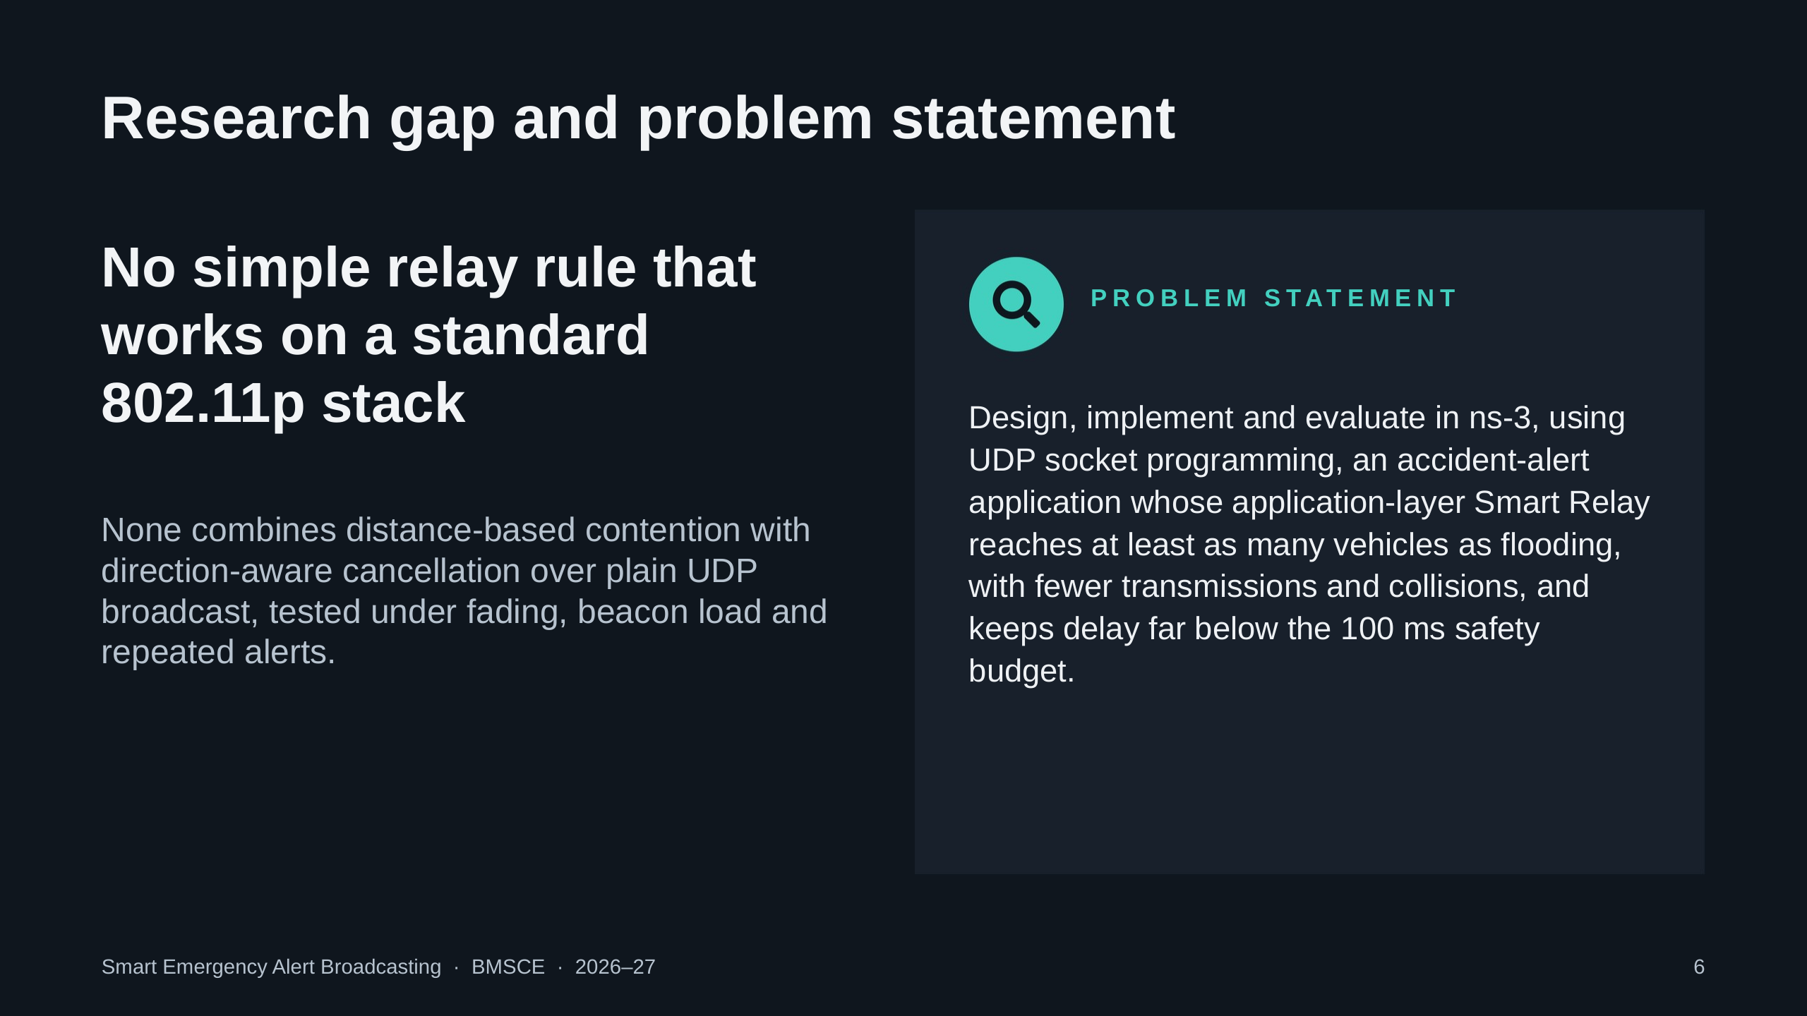
Notes:
Our gap, narrowed to one: there is no simple relay rule that a socket programmer could deploy on an unmodified 802.11p stack, combining distance-based contention with direction-aware cancellation, evaluated against flooding and gossip under realistic fading, background beacons and repeated alerts. The problem statement on the right is exactly what the rest of the talk delivers.

Slide 7
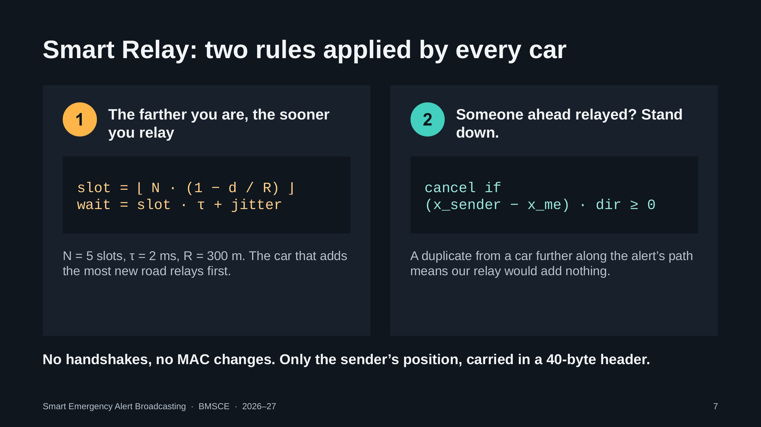
Notes:
Rule one: when you first hear an alert, wait a time that shrinks with your distance from the sender. With 5 slots of 2 ms and a nominal range of 300 m, a car near the edge of range relays almost at once, and a car next to the sender waits up to about 8.5 ms. Rule two: while waiting, if you hear the same alert from a car at or beyond you in the direction the alert is travelling, cancel. Duplicates from behind are ignored, so you are never silenced by the copy that reached you.

Slide 8
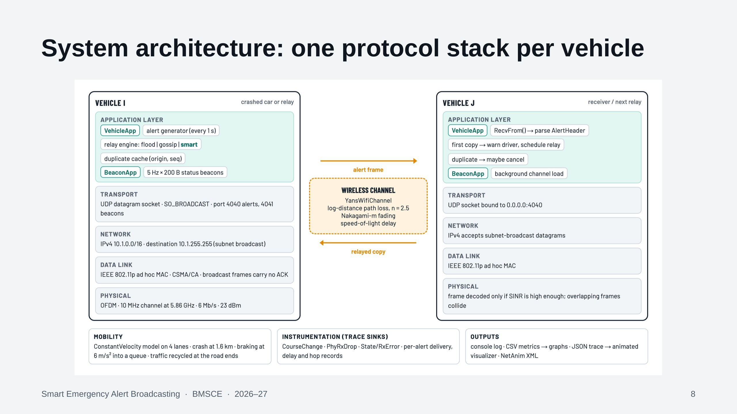
Notes:
Every vehicle is an ns-3 node with a complete stack. VehicleApp is our alert application: it generates alerts on the crashed car, receives them everywhere else, keeps a duplicate cache keyed by origin and sequence number, and runs the relay engine (flooding, gossip or Smart Relay). BeaconApp adds five 200-byte beacons per second per car. Below: UDP socket, IPv4 subnet broadcast, the 802.11p ad hoc MAC and the OFDM PHY. All cars share one channel with log-distance path loss and Nakagami fading.

Slide 9
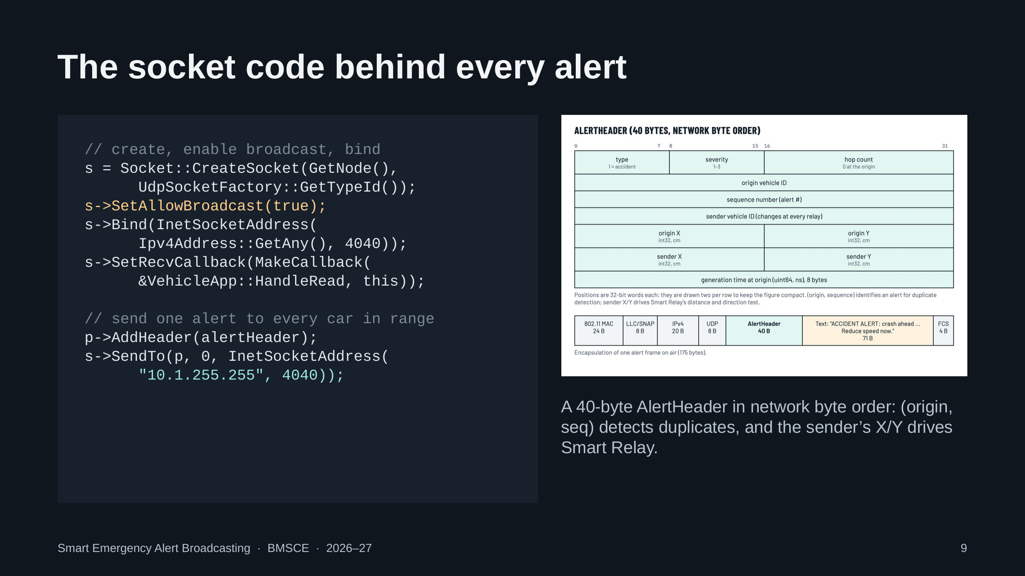
Notes:
This is the network-programming core. Each car creates a UDP datagram socket, enables broadcast (SO_BROADCAST in C), binds to port 4040 on all addresses and registers a receive callback. Sending is AddHeader, then SendTo the subnet broadcast address 10.1.255.255. The receive side uses RecvFrom in a loop and RemoveHeader. The AlertHeader is 40 bytes in network byte order; origin and sequence number identify an alert for duplicate detection, and the sender's position, rewritten by every relay, drives Smart Relay.

Slide 10
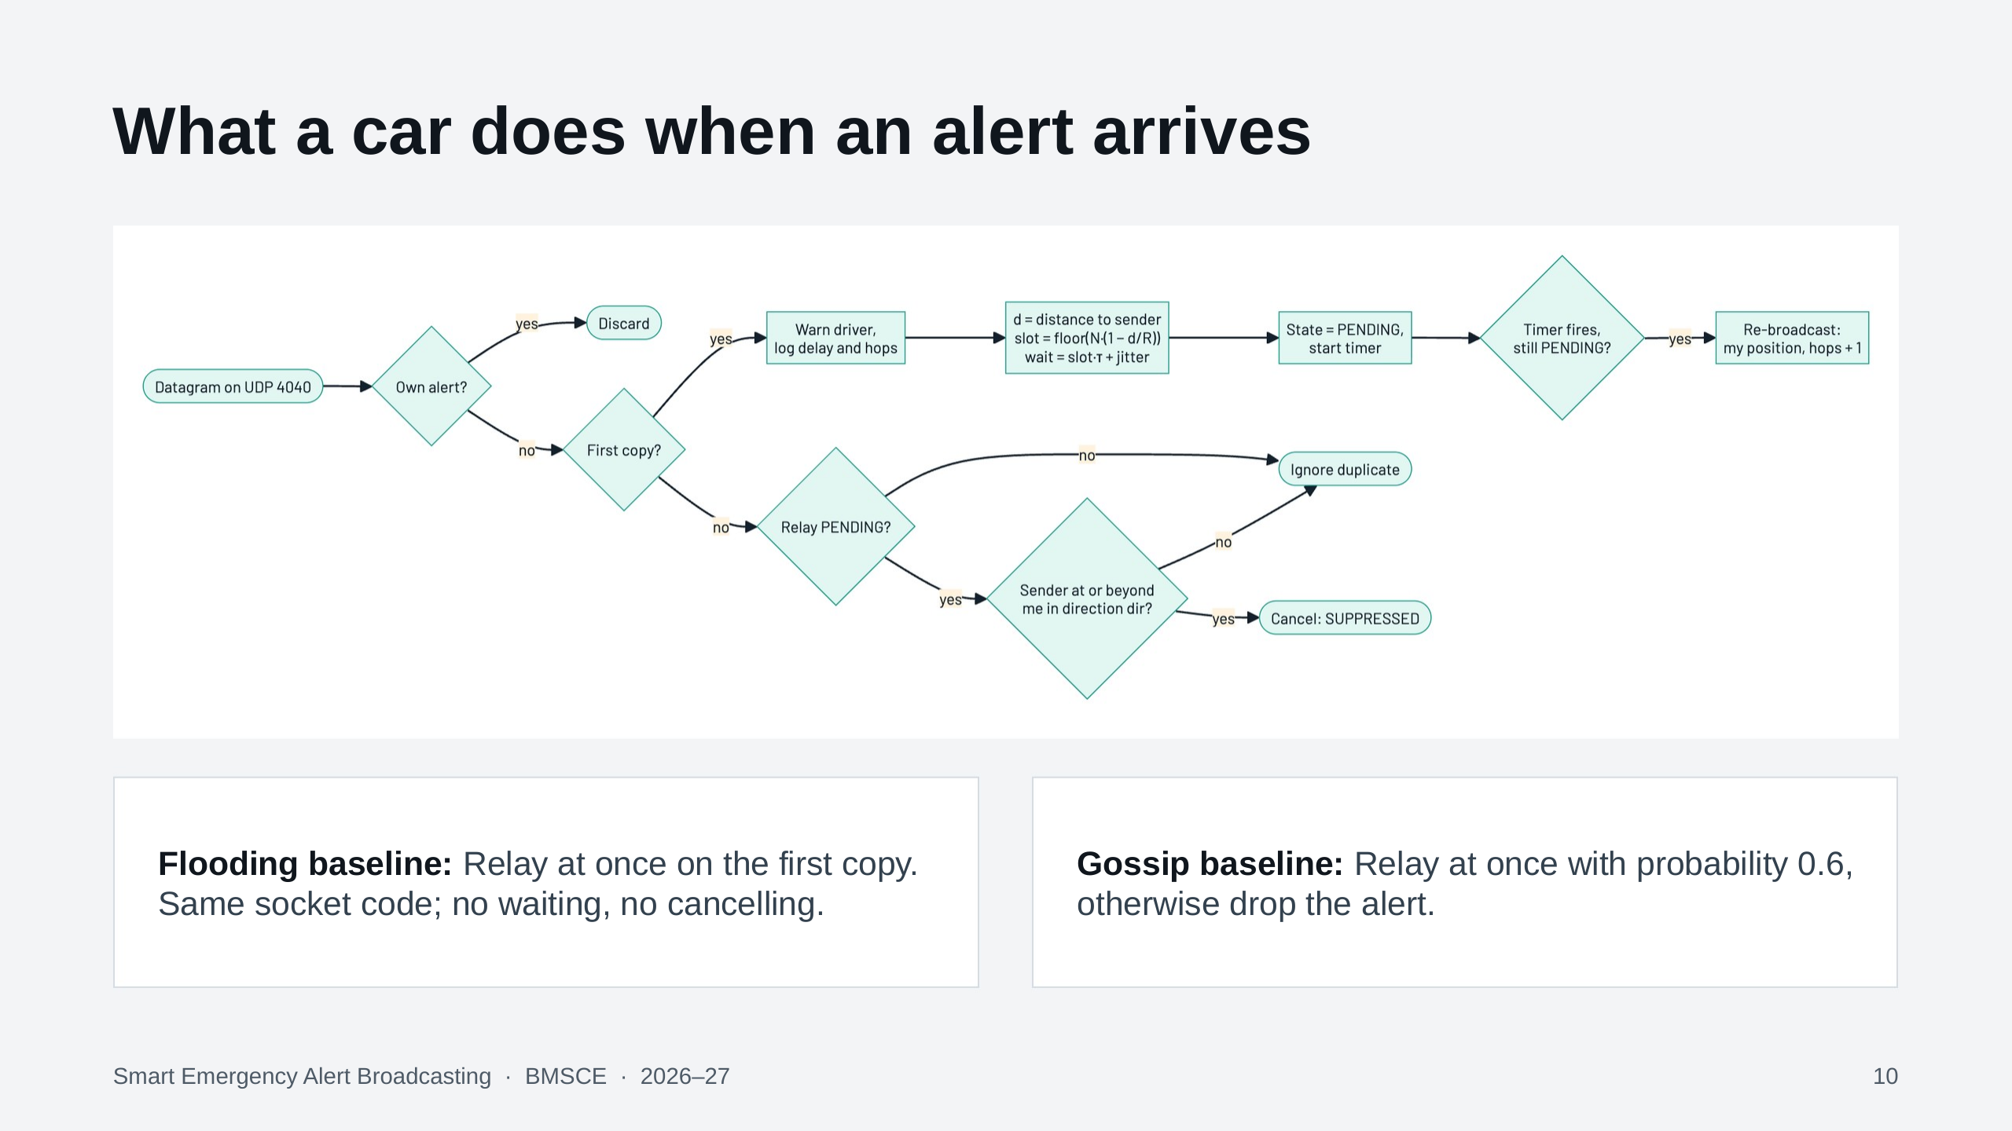
Notes:
Walk the flowchart left to right. If the datagram is our own alert echoed back, discard it. On the first copy, warn the driver, log delay and hop count, compute the slot from the distance and start a timer; when it fires and we are still pending, re-broadcast with our own position and hops plus one. On a duplicate while pending, cancel if the sender is at or beyond us in the alert's direction. The baselines run in the same application; only this decision differs.

Slide 11
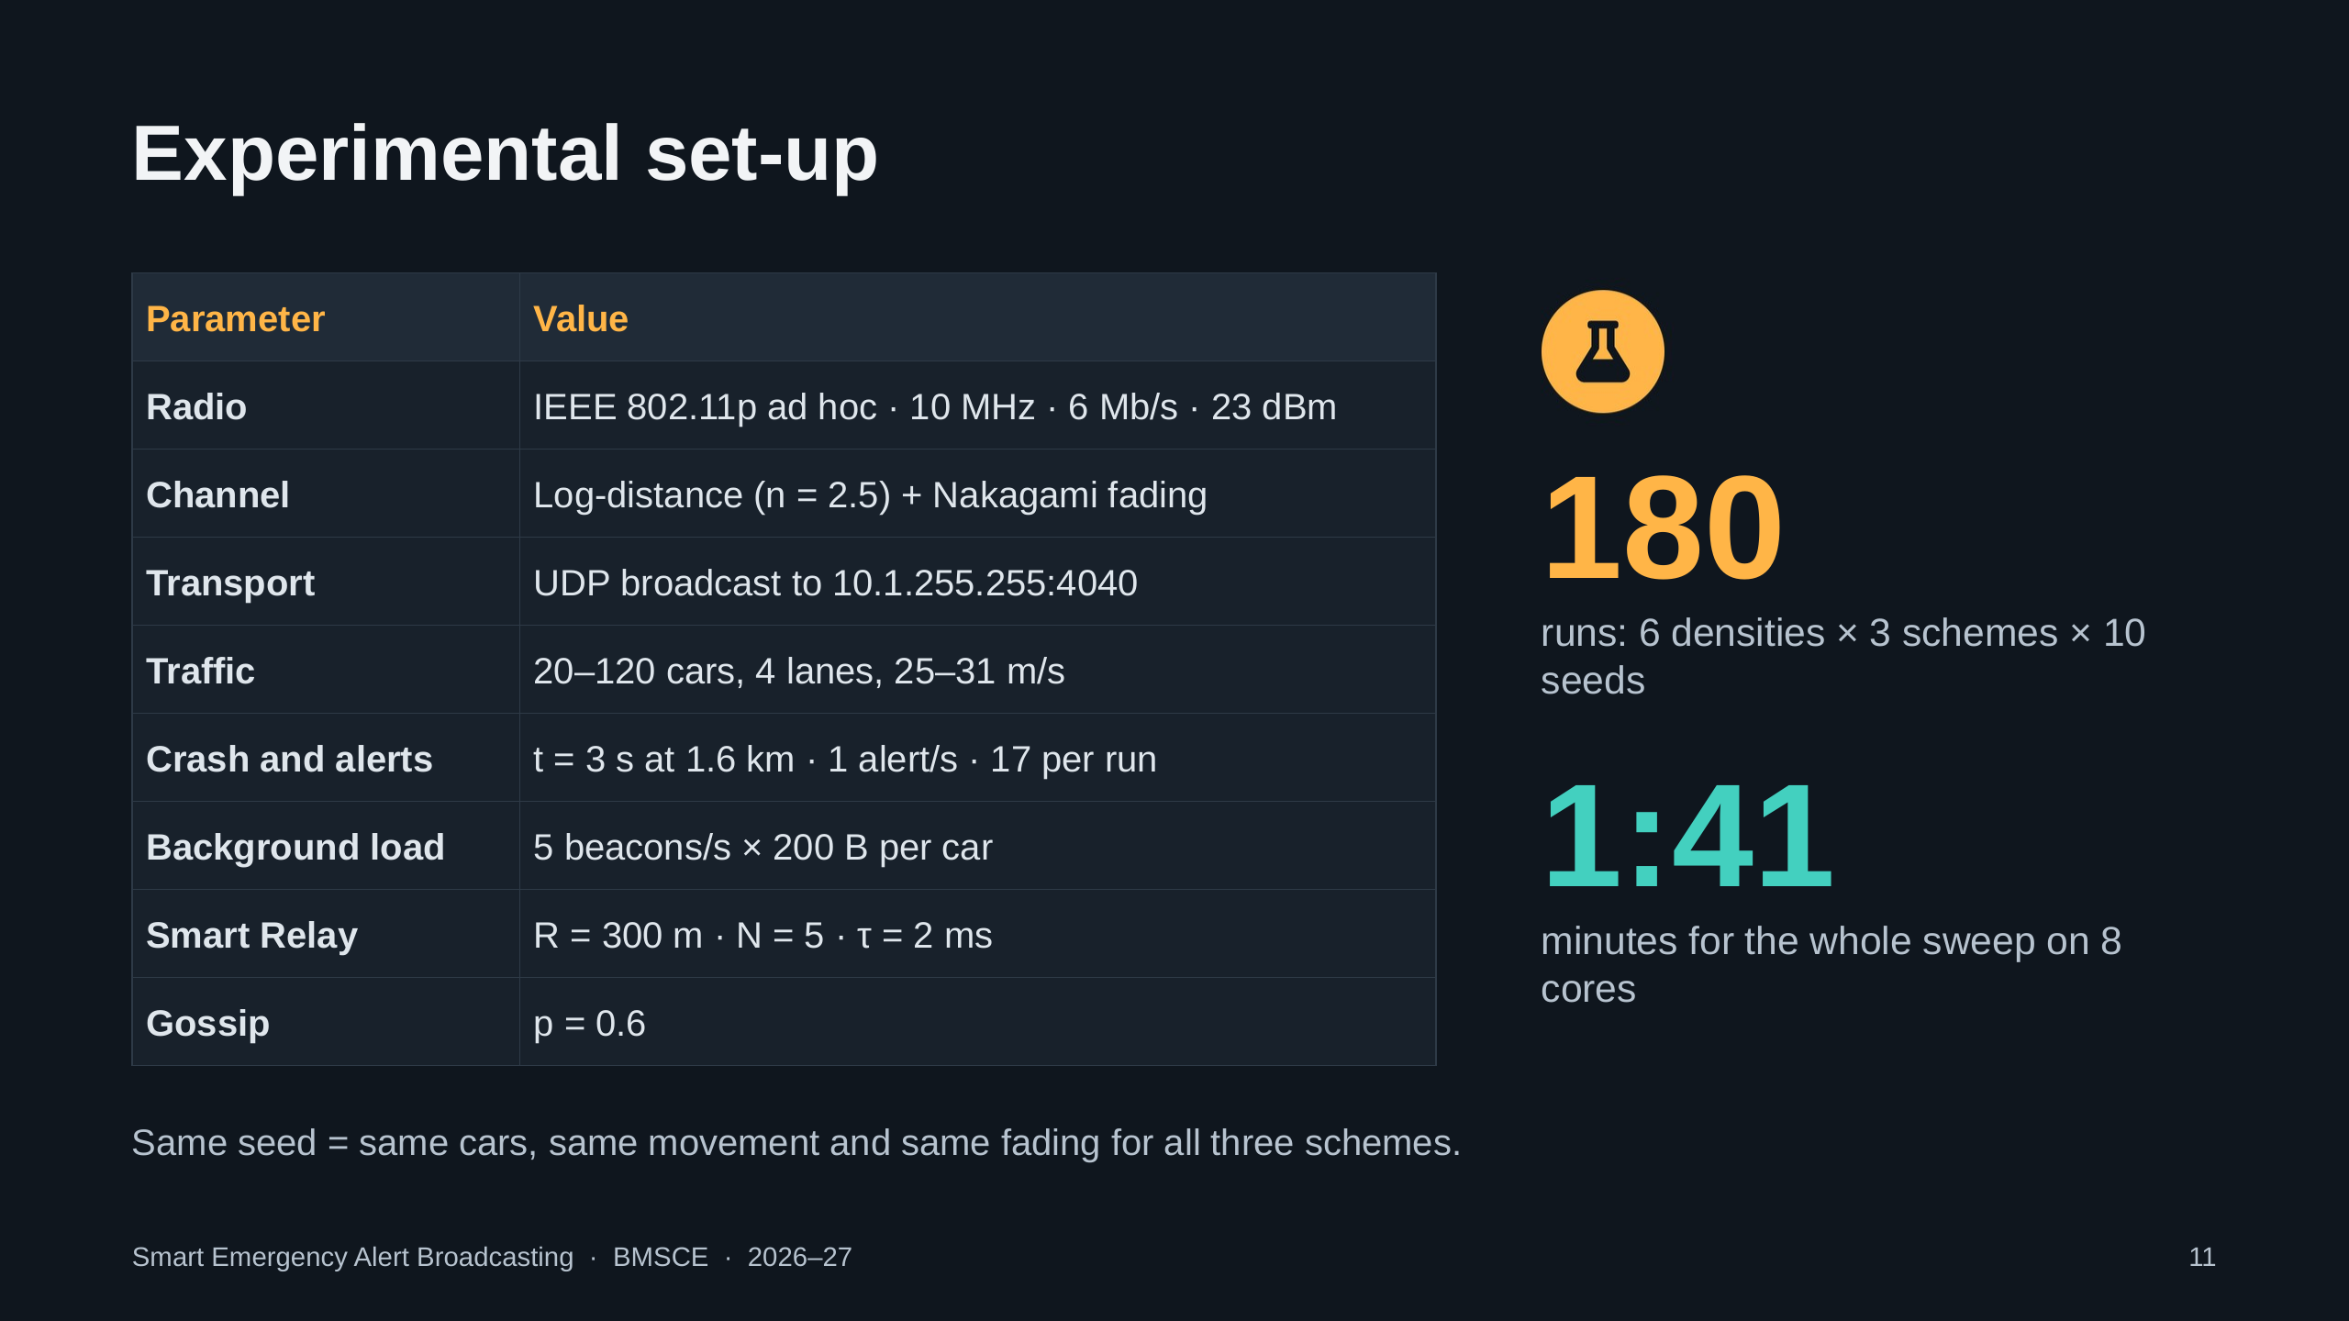
Notes:
Real 802.11p at 6 megabits on a 10 MHz channel, a fading channel, UDP broadcast, 20 to 120 cars, and five background beacons per second per car. We ran every combination of six densities, three schemes and ten seeds: 180 runs in 1 minute 41 seconds. Every random stream is pinned, so for a given seed all three schemes see the same cars and channel; only the relay rule differs.

Slide 12
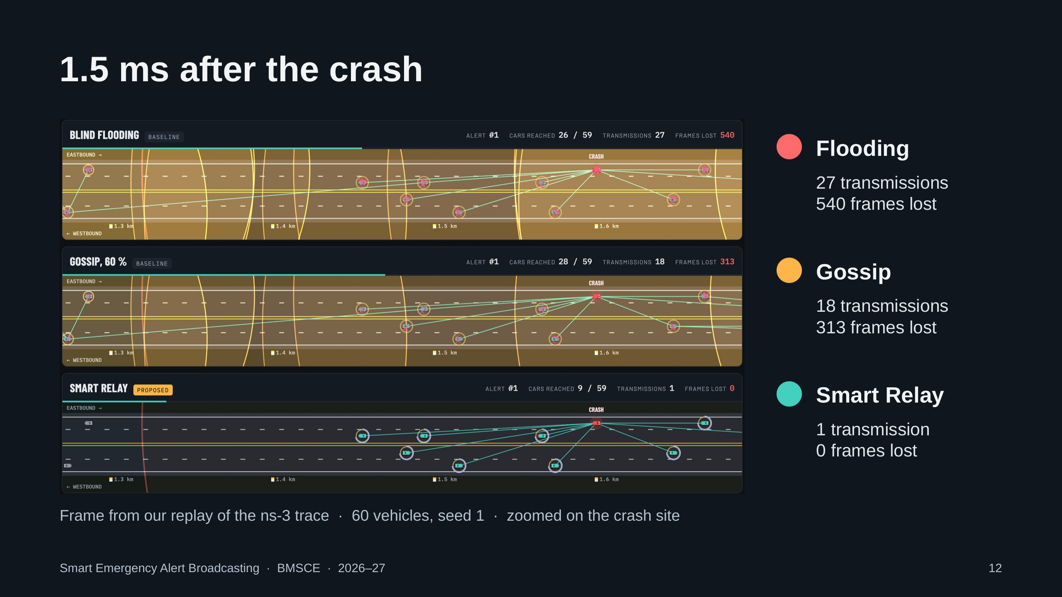
Notes:
A real frame from our replay, 1.5 milliseconds after the crash, zoomed in on the crash site, with the same cars in all three strips. In flooding every car that heard the alert is already transmitting: the amber rings are radio transmissions and the pink marks are frames destroyed by collisions, 540 already. In Smart Relay only the crashed car has transmitted; the blue arcs are countdown timers, and the farthest car is about to go first.

Slide 13
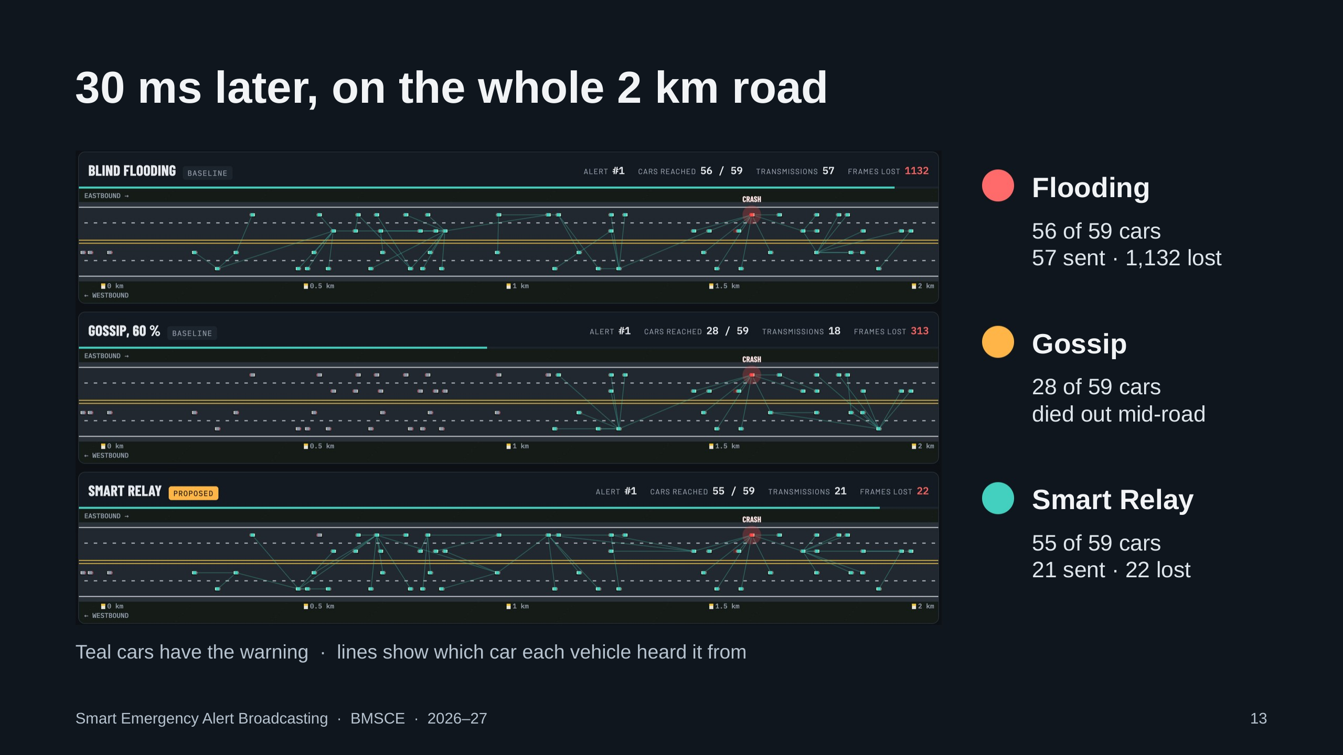
Notes:
Thirty milliseconds later on the whole road. The teal lines show who each car first heard the alert from. Flooding reached 56 of 59 cars but needed 57 transmissions and lost 1,132 frames. Gossip stopped at 28 cars: the alert died out mid-road, the all-or-nothing behaviour reported by Haas et al. Smart Relay reached 55 cars with 21 transmissions and 22 lost frames; over all 17 alerts this run it delivered 98.7 percent against flooding's 91.8.

Slide 14
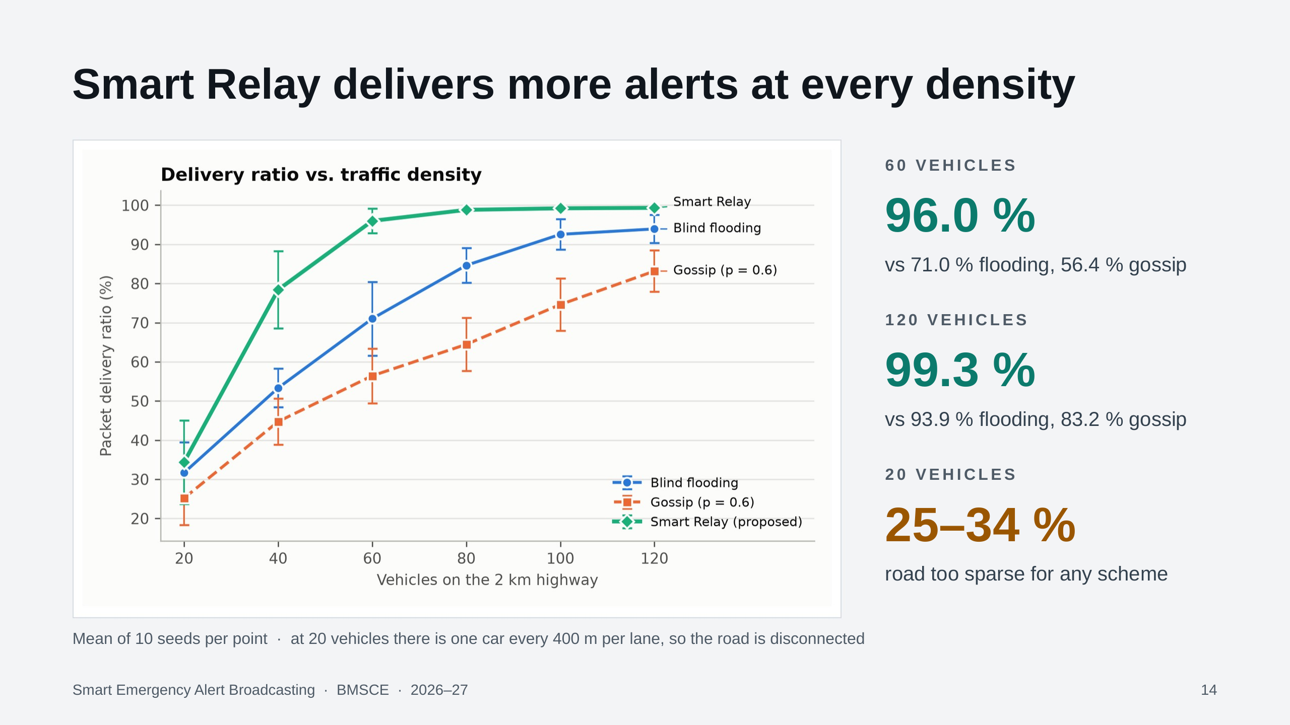
Notes:
Packet delivery ratio is the share of cars on the section that received each alert. Smart Relay is on top at every density. The biggest gap is at medium density: 96 percent against 71 for flooding at 60 vehicles. Even at 120 vehicles it is 99.3 against 93.9. At 20 vehicles every scheme is around 30 percent because the road is physically disconnected; no relay rule can jump a gap wider than the radio range.

Slide 15
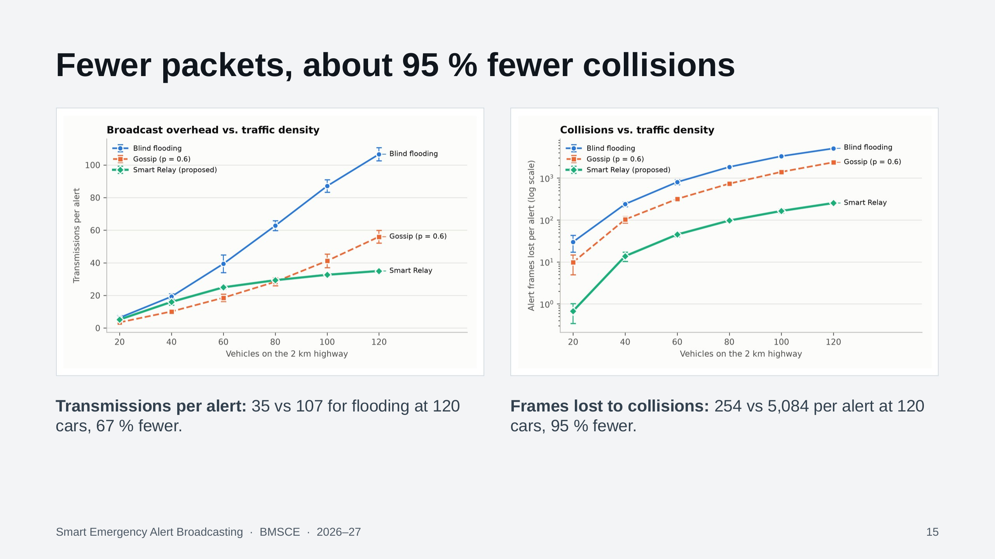
Notes:
Why does Smart Relay deliver more? Because it uses the channel far less. Flooding's transmissions grow in a straight line with the number of cars, since every receiver transmits; Smart Relay's barely grow because extra cars mostly cancel their relays: at 120 cars, 35 transmissions against 107. Frames destroyed by collisions, on a log scale on the right, are about 95 percent lower at every density from 40 cars up.

Slide 16
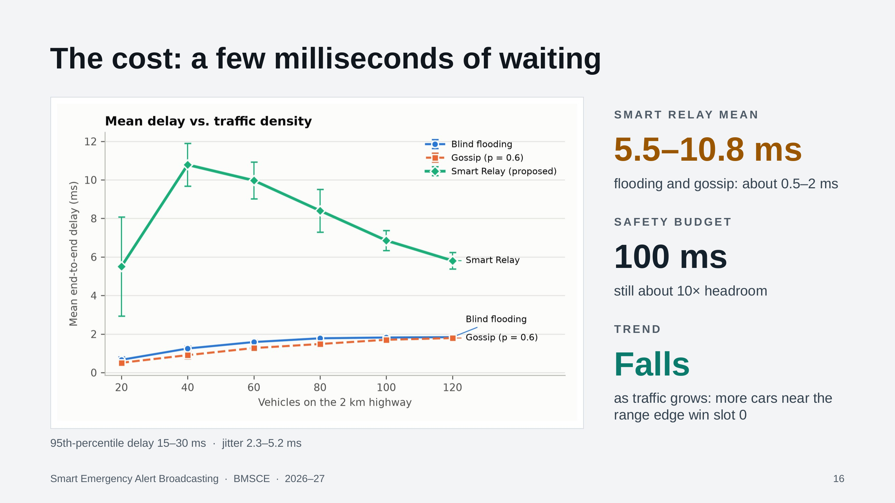
Notes:
The honest trade-off. Flooding and gossip relay instantly, so their delay is one or two milliseconds. Smart Relay deliberately waits, so its mean delay is 5.5 to 10.8 milliseconds and the 95th percentile is 15 to 30. That is still about ten times below the 100 millisecond budget for safety warnings, and it improves with traffic, because denser roads more often have a car near the edge of range that gets slot zero.

Slide 17
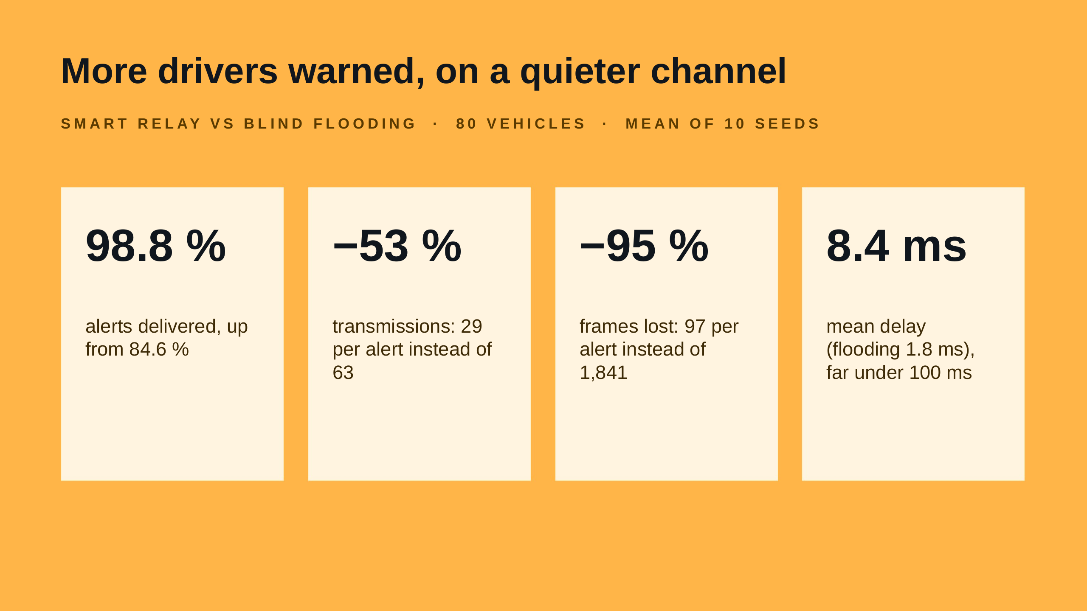
Notes:
One slide to remember. At 80 vehicles, compared with blind flooding, Smart Relay warns 98.8 percent of drivers instead of 84.6, sends 53 percent fewer packets, loses 95 percent fewer frames to collisions, and pays with 8.4 milliseconds of mean delay, still more than ten times inside the safety budget.

Slide 18
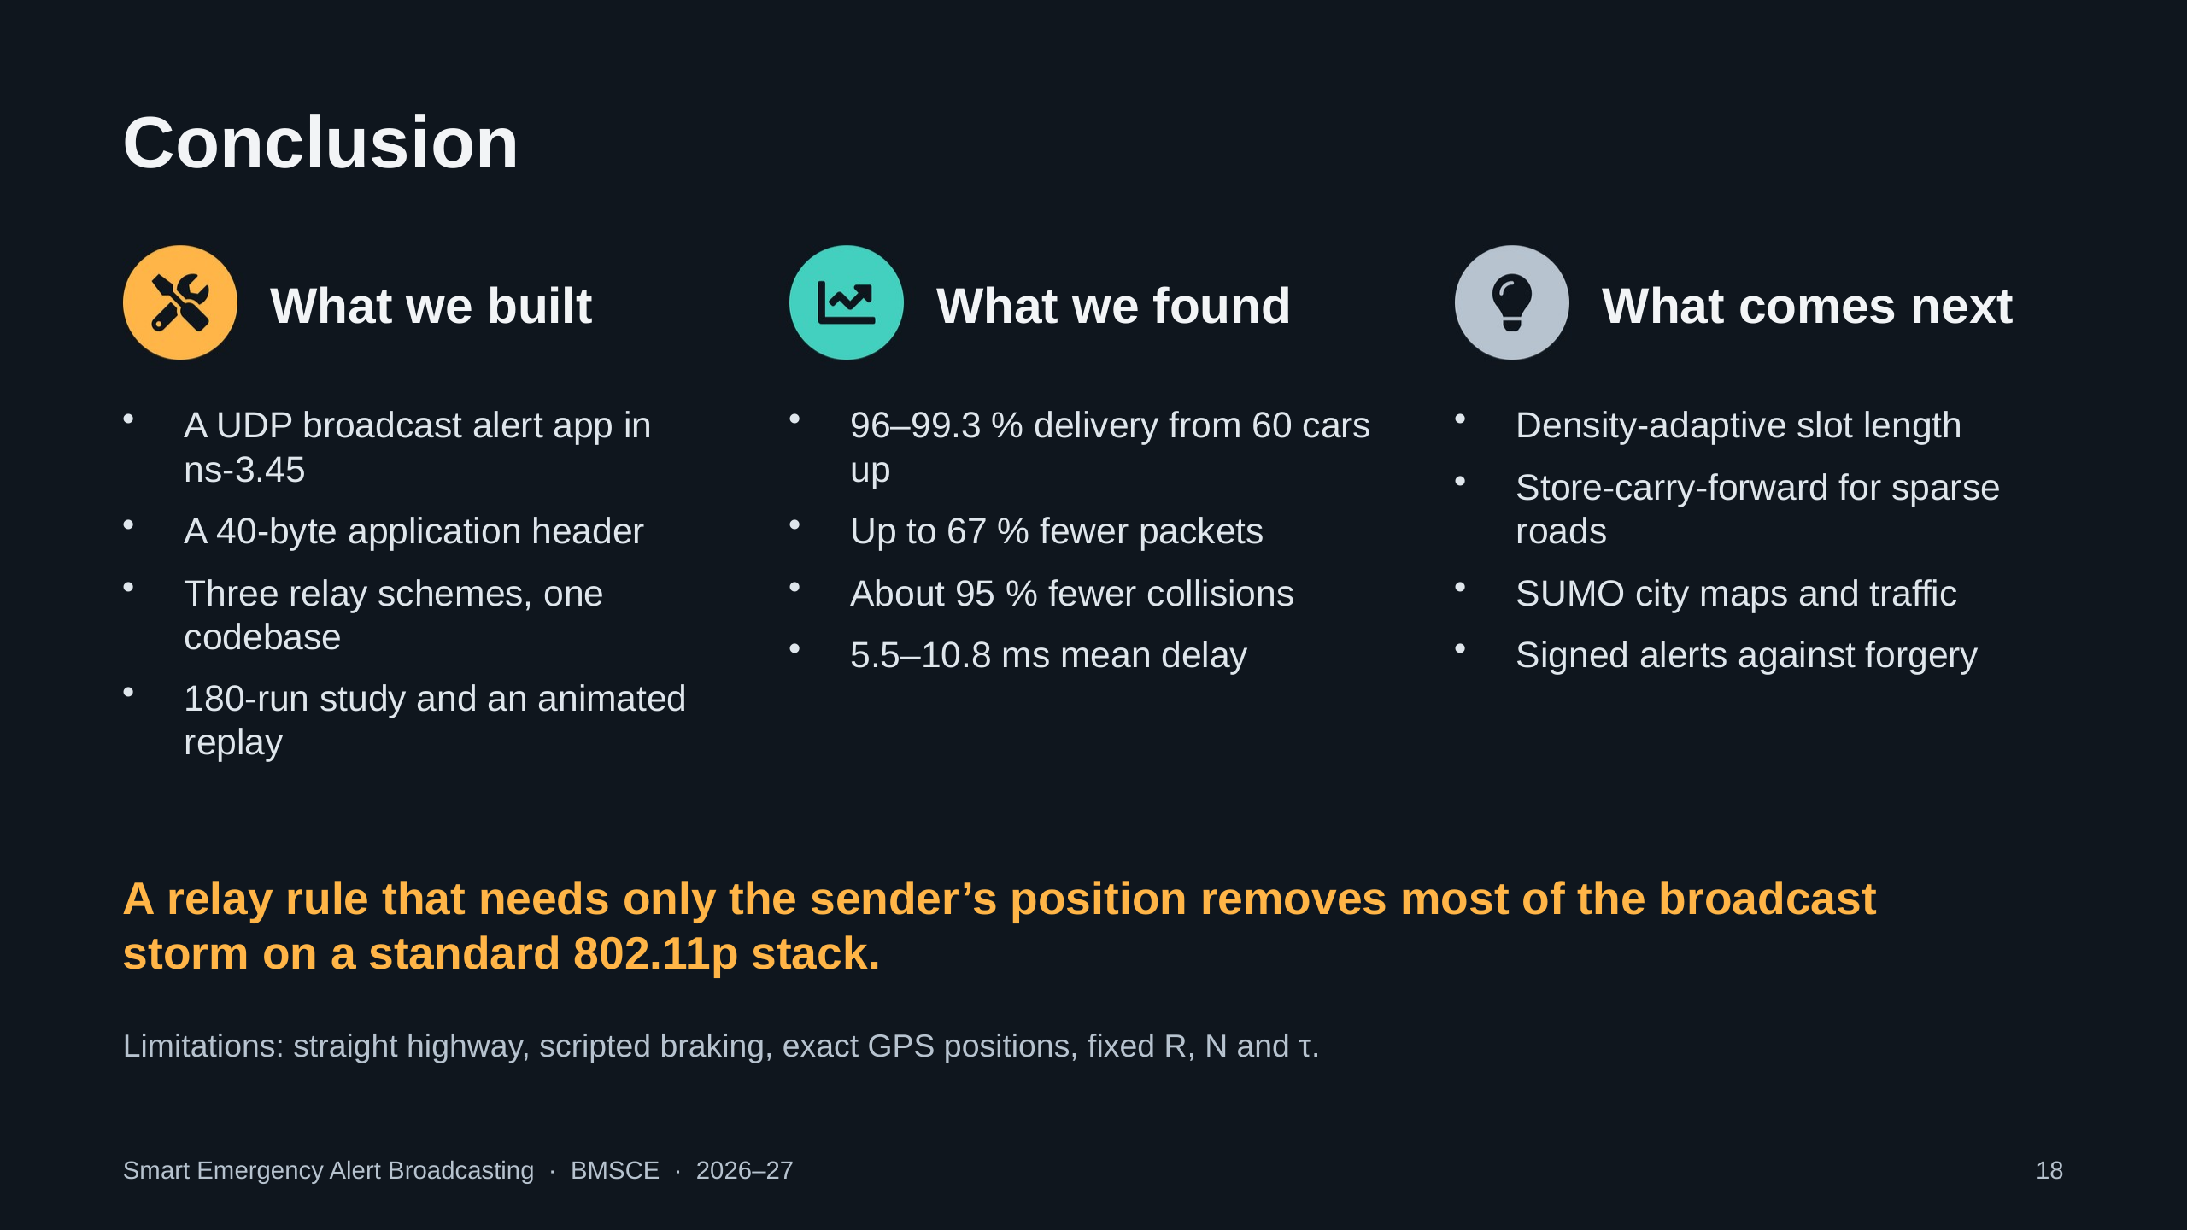
Notes:
We built a complete UDP broadcast alert application in ns-3.45 with its own header, three relay schemes in one codebase, a 180-run study and an animated replay. Smart Relay delivered 96 to 99.3 percent of alerts from 60 cars up, with up to 67 percent fewer packets and about 95 percent fewer collisions, at 5.5 to 10.8 milliseconds of delay. Limitations: a straight highway, scripted braking, exact GPS positions and fixed parameters. Next: adaptive slots, store-carry-forward, SUMO maps and signed alerts.

Slide 19
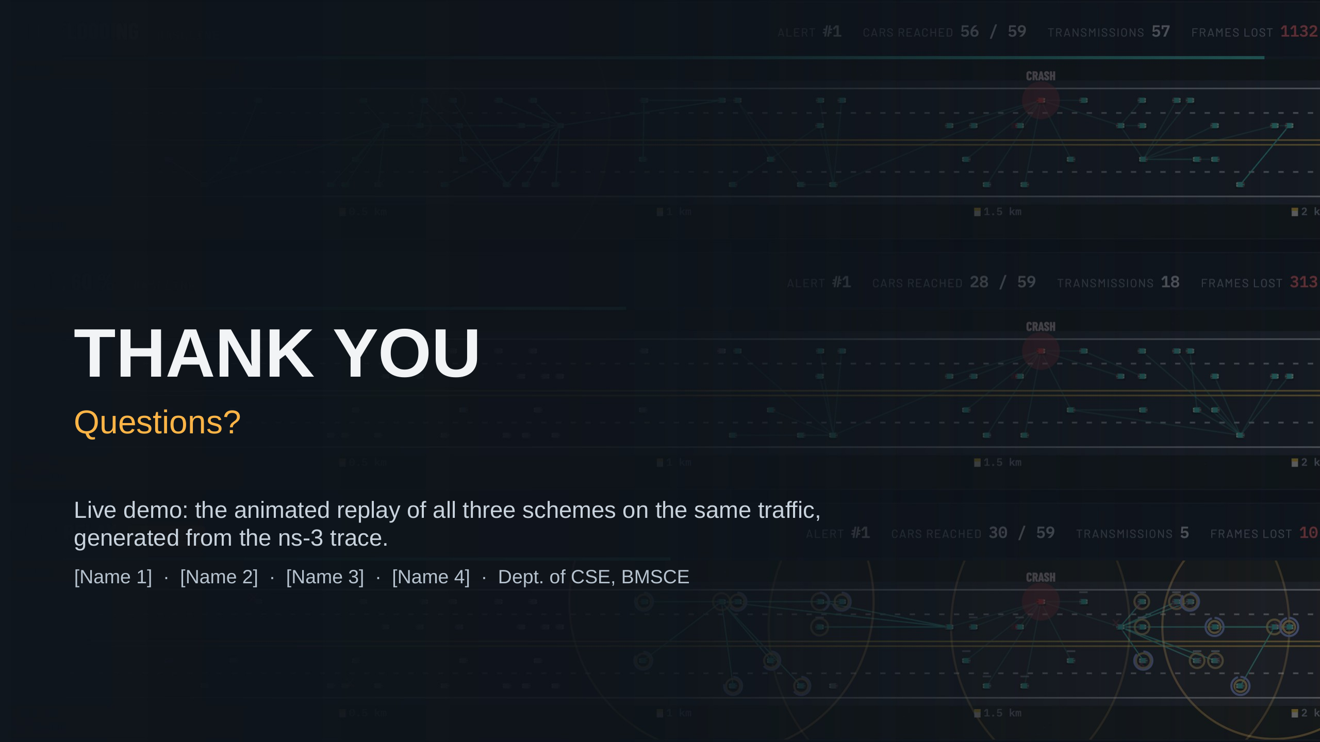
Notes:
Thank the audience and the guide, then switch to the live replay: open visualizer/index.html through a local server, press Play, and let the slow motion show the flooding storm next to Smart Relay. Use the Crash site button and the alert arrows to step between alerts.

